Slide 1


Task 1 presentation
Data Analysis Project
Presented by
Mahmoud Ahmed Mohamed Ahmed Aref

Slide 2
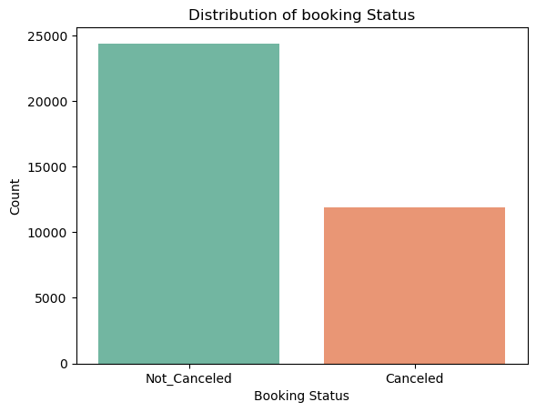
Q1: What is the distribution of booking status (canceled vs not_canceled)?
The graph shows the proportion of canceled versus non-canceled bookings. A balanced distribution suggests stable booking behavior,
while a high cancellation rate may indicate issues like pricing, policies, or customer dissatisfaction.

Slide 3

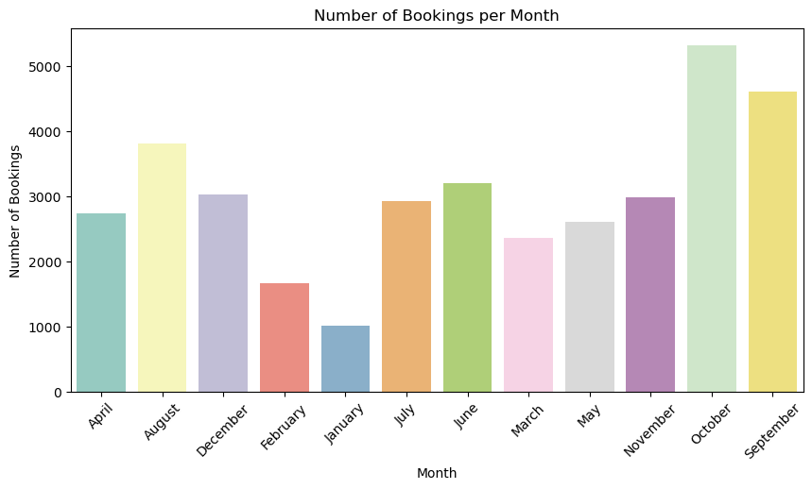
Q2: How many bookings are made per month?
This graph displays booking trends over months. Peaks may correlate with holidays or seasons,
while dips could reflect low-demand periods, helping the hotel plan staffing and promotions.

Slide 4
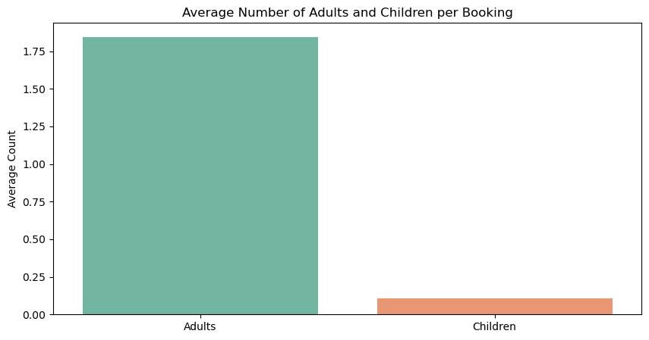
Q3: What is the average number of adults and children per booking?
The graph compares the average number of adults and children per booking. Higher adult numbers might indicate business travel,
while more children suggest family stays, guiding room and amenity offerings.

Slide 5
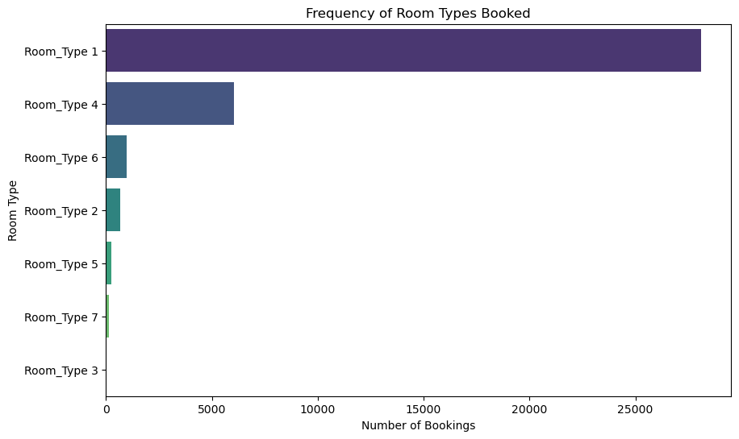
Q4: What is the most common room type booked?
This graph ranks room types by popularity. The dominant type (e.g., "Standard" or "Suite") can inform inventory management and marketing strategies.

Slide 6

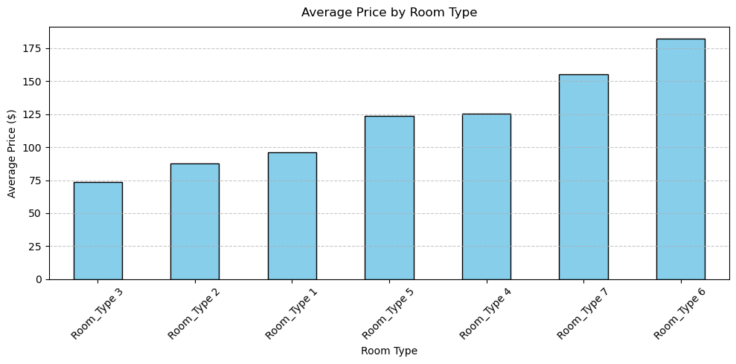
Q5: Is there a relationship between room type and average price?
The graph explores price variation across room types. A clear trend (e.g., suites costing more) confirms pricing logic, while outliers may need review.

Slide 7
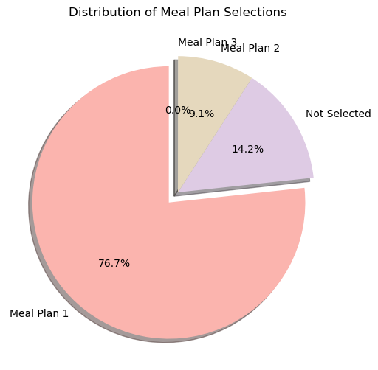
Q6: Which meal plan is most selected by guests?
The graph highlights guest preferences for meal plans (e.g., "Breakfast Included"). Popular plans can be emphasized in promotions to attract bookings.

Slide 8
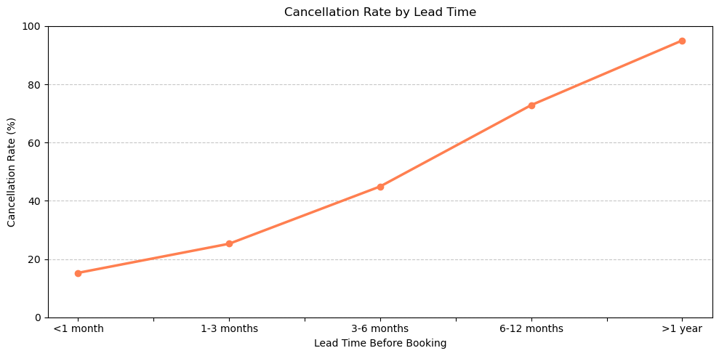
Q7: Do longer lead times correlate with cancellation rates?
This graph examines whether longer lead times correlate with higher cancellations. A positive trend suggests early bookers are more likely to cancel,
prompting policy adjustments.

Slide 9
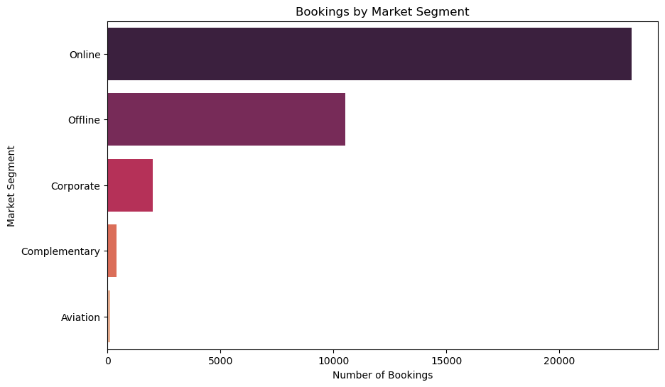
Q8: Which market segment contributes most to bookings?
The graph shows which segment (e.g., "Online Travel Agents" or "Direct") drives most bookings.
Dominant segments should be prioritized in marketing efforts.

Slide 10

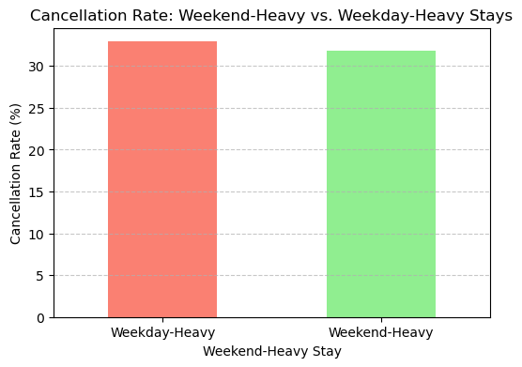
Q9: Do weekend bookings have a higher cancellation rate than weekday bookings?
Comparing cancellation rates by weekend/weekday reveals patterns. Higher weekend cancellations might reflect leisure travelers' unpredictability.

Slide 11
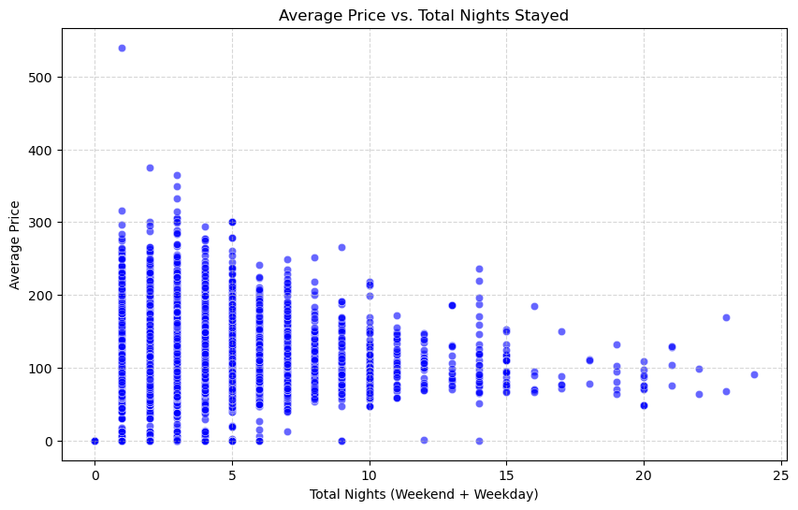
Q10: Is there a relationship between the average price and the number of nights stayed?
The graph checks if longer stays correlate with price discounts. A downward trend could indicate extended-stay promotions are effective.

Slide 12
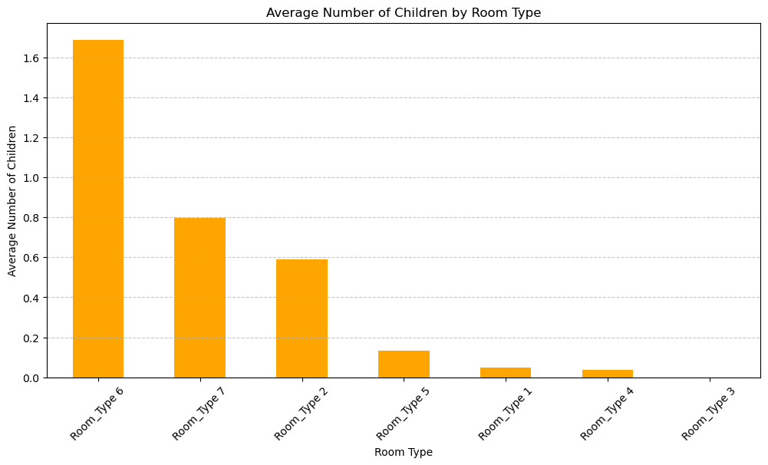
Q11: How does the number of children affect the room type selection?
This graph shows room preferences for families with children.
Larger families may prefer interconnected rooms, guiding room design and promotions.

Slide 13
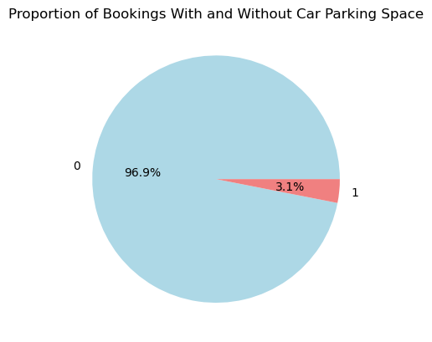
Q12: What is the proportion of bookings with and without car parking space?
The proportion of guests needing parking helps assess demand. Low parking usage might suggest a city-center location with alternative transport.

Slide 14
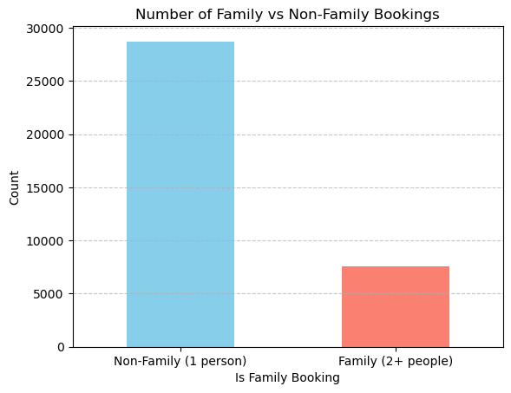
Q13: How many bookings are made by families (adults + children > 1)?
This graph counts family-sized bookings.
High numbers may justify family-friendly amenities or packages to attract this demographic.

